Slide 1
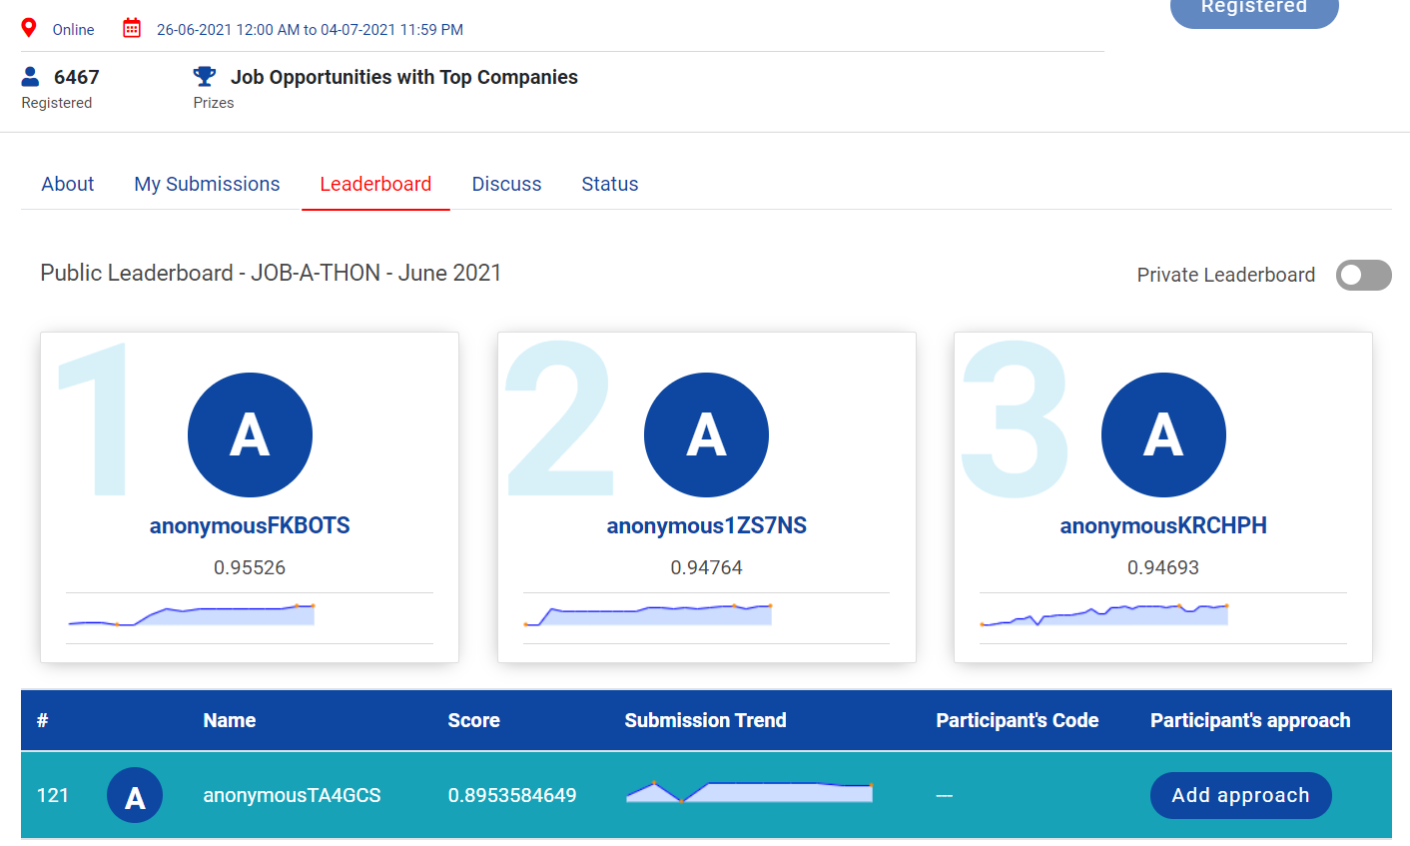

Slide 2

JOB-A-THON – 2021 Marketplace Feature Data Engineering (Used Python)
Kumar Gourabh
kumargourabh94@gmail.com
8130803199

Slide 3
Given Problem:
Being part of the data engineering team, we are expected to “Develop input features” for the efficient marketing model given the Visitor log data and User Data.
In the current case, we are supposed to generate an input feature set as on 28-May-2018.
This will be used by The Data Science Team to Model Marketing Predictions

Slide 4
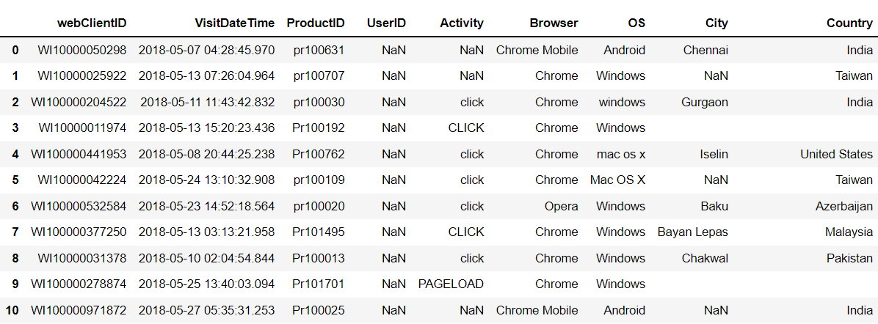
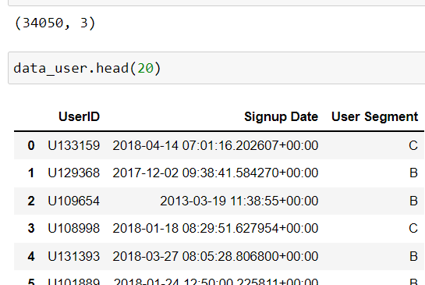
Loaded given datasets – User Details and Product Details

Slide 5
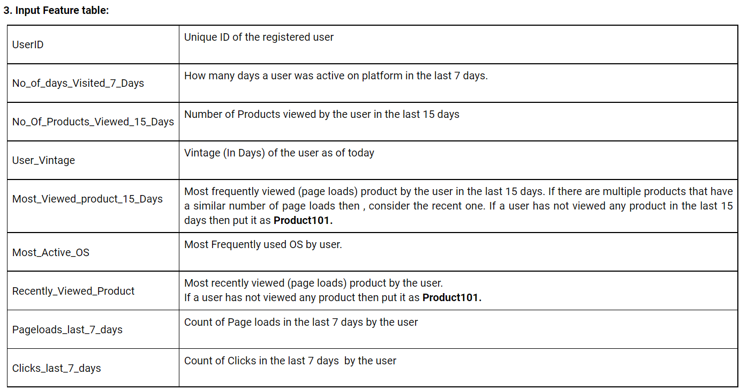
Desired Output Table

Slide 6
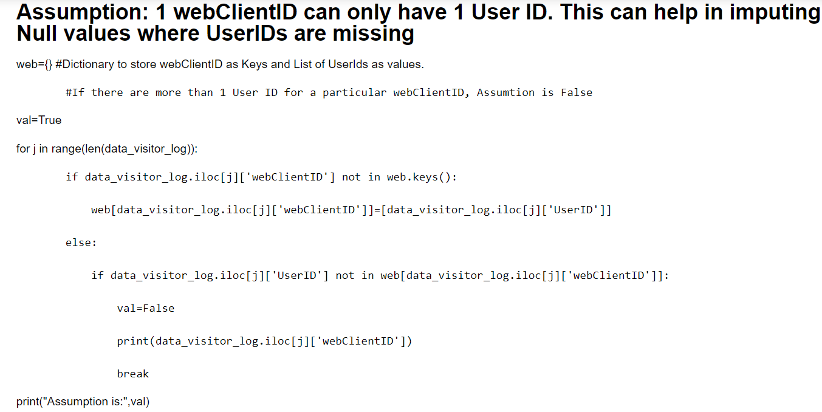
Data Cleaning & Preprocessing
Wanted to impute missing User IDs using Web Client IDs but couldn’t find new values.

Slide 7
Steps
Removed rows without UserID from visitor_log table
I used UserID Column to merge the 2 user_details table and visitor_logs table using left join.

Slide 8
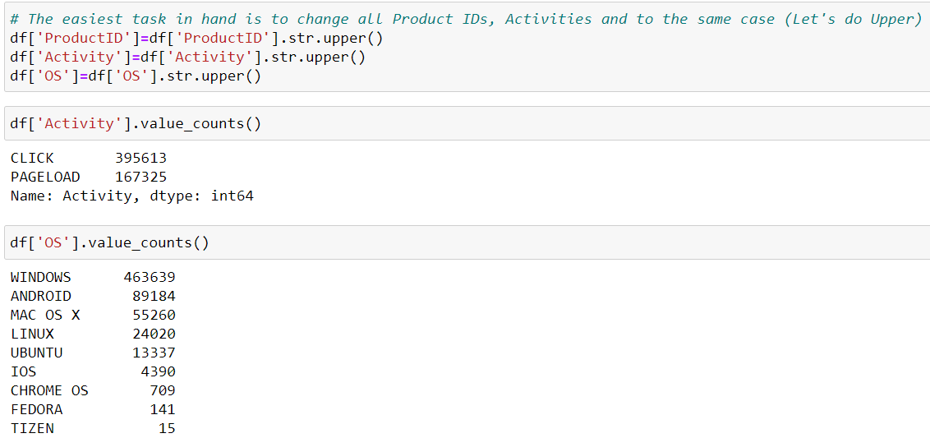
Case Conversion

Slide 9
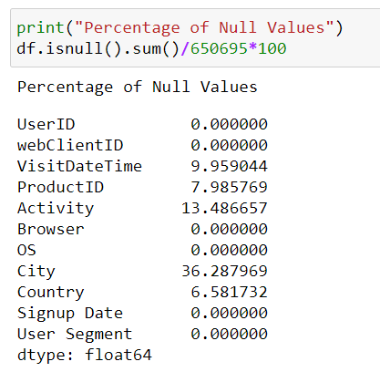
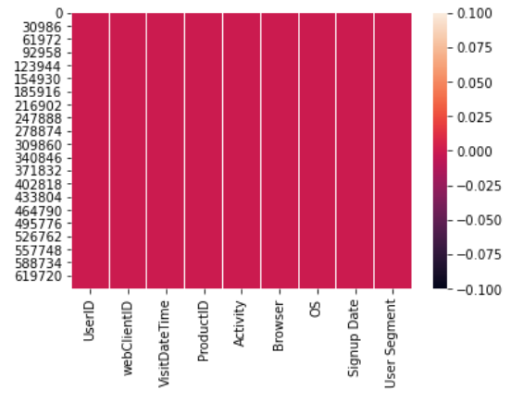
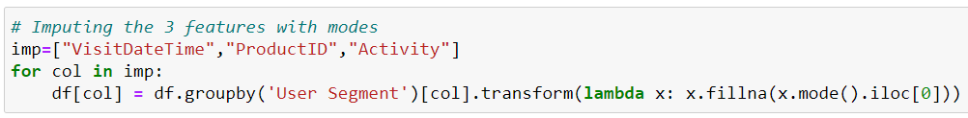
Treating and Imputing Null Values

Slide 10
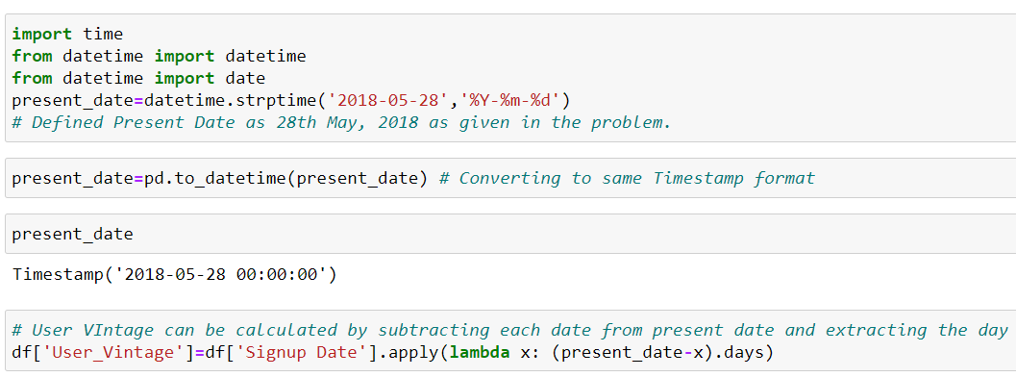
Handling Date Time Columns

Slide 11
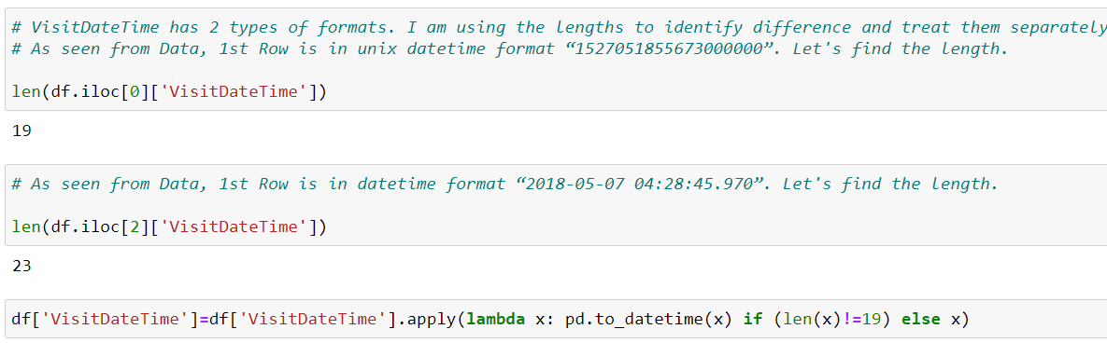
Treating Multiple Date Time Formats in “Visit Date”.

Slide 12
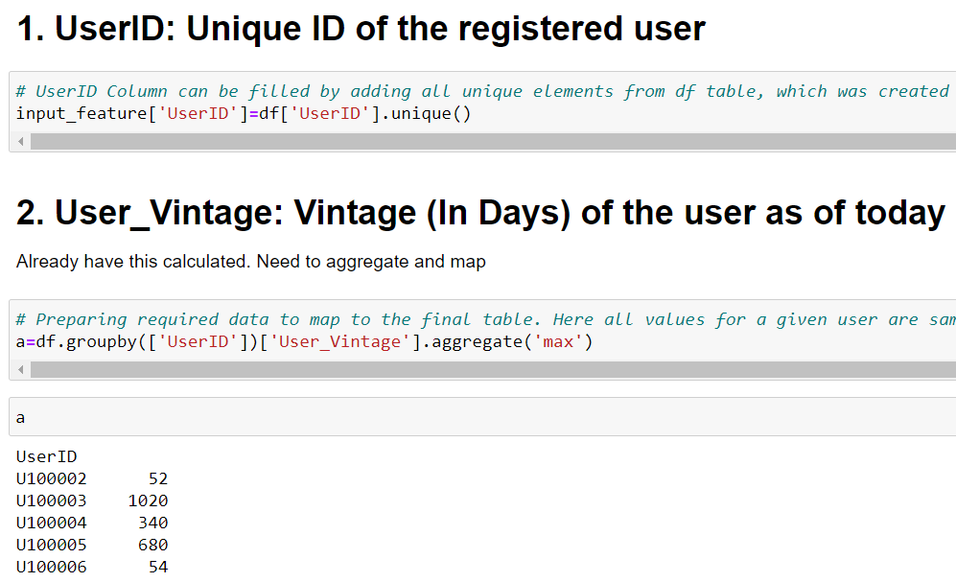
Creating Input Features Table

Slide 13
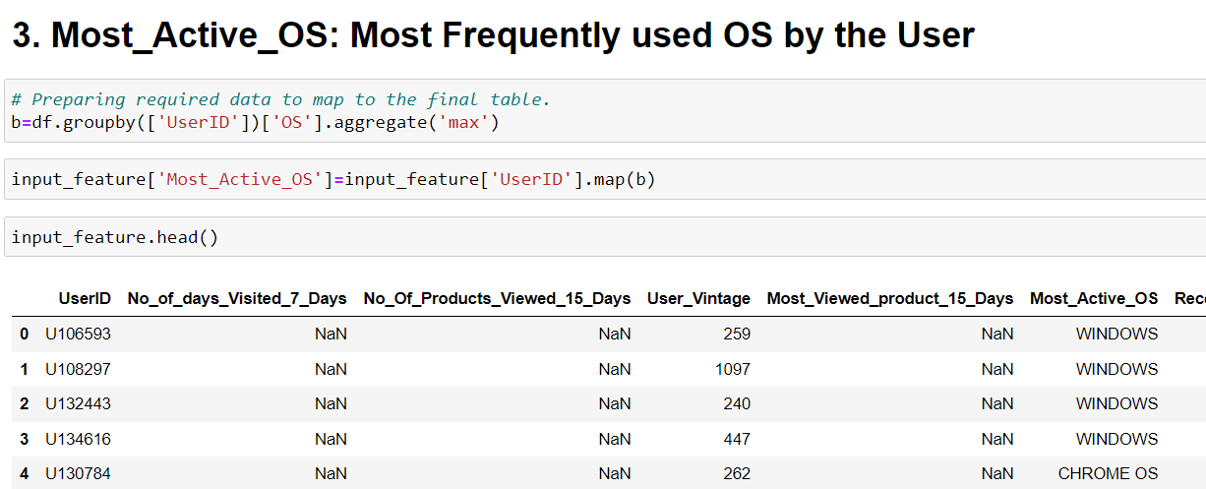

Slide 14
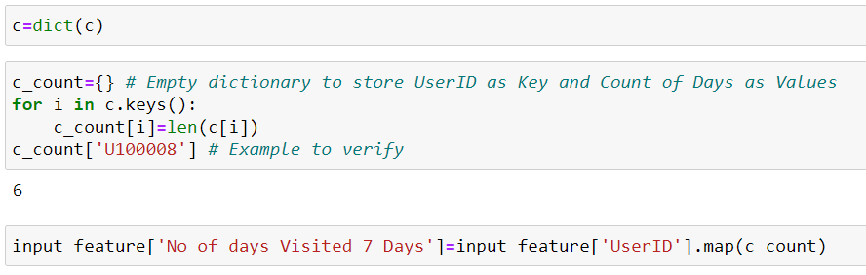
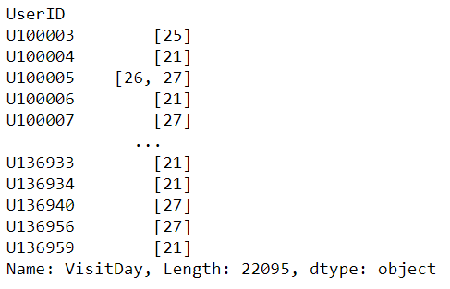
4. No_of_days_Visited_7_Days: How many days a user was active on platform in the last 7 days.

Slide 15
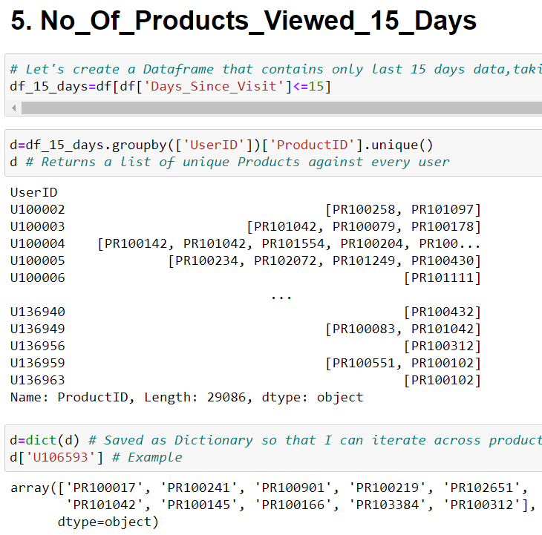
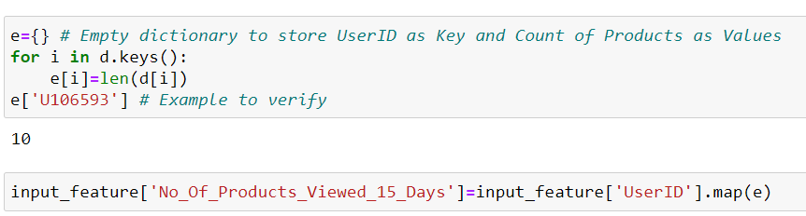

Slide 16
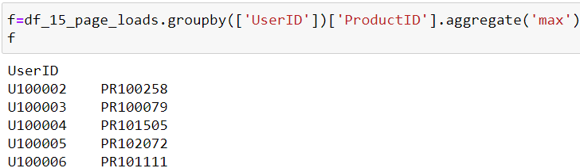
6. Most Viewed product_15_Days:
# Created Dataframe for <=15 Days and Activity type - Page Loads
df_15_page_loads=df[df['Days_Since_Visit']<=15][df['Activity’]== 'PAGELOAD’]
Sorted Based on Visit DateTime, so gthat in case of draw, recent one is picked by ‘max’ function

Slide 17
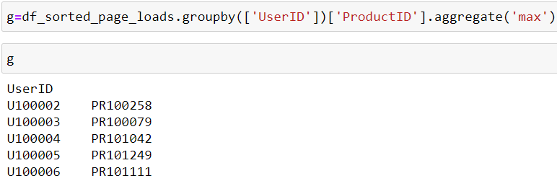
7. Recently_Viewed_Product: Most recently viewed (page loads) product by the user
Sorted
Filtered by Activity
Created required elements as g
Mapped Based on UserID

Slide 18
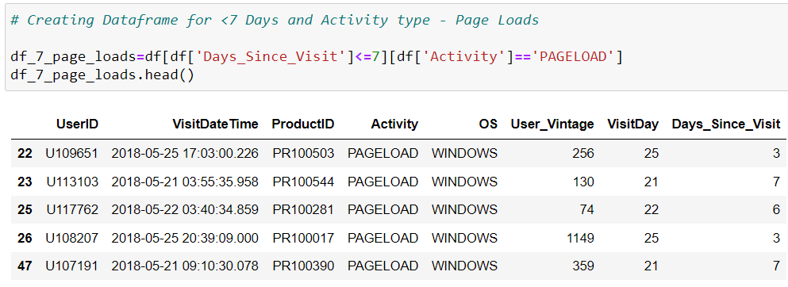
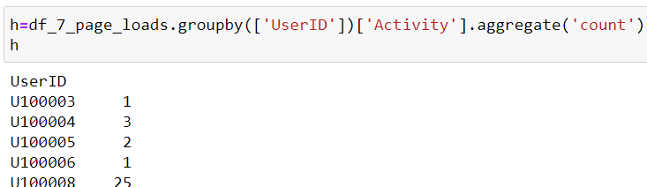
8. Pageloads_last_7_days : Count of Page loads in the last 7 days by the user
Same approach for 9, Clicks _last_7_days

Slide 19
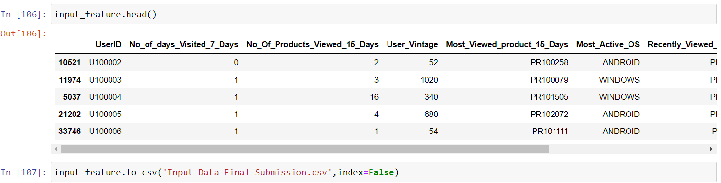
Finalized Output and Saved as CSV

Slide 20
Notes
I have replaced Nulls with Zero’s and Product101, where applicable
Converted Final Values to int as per sample file.
Earlier I have used User Segment to group by for imputing modes for null values/ but changed it to use overall mode as it was giving better score.
Used Random values for Visit Time

